Slide 1
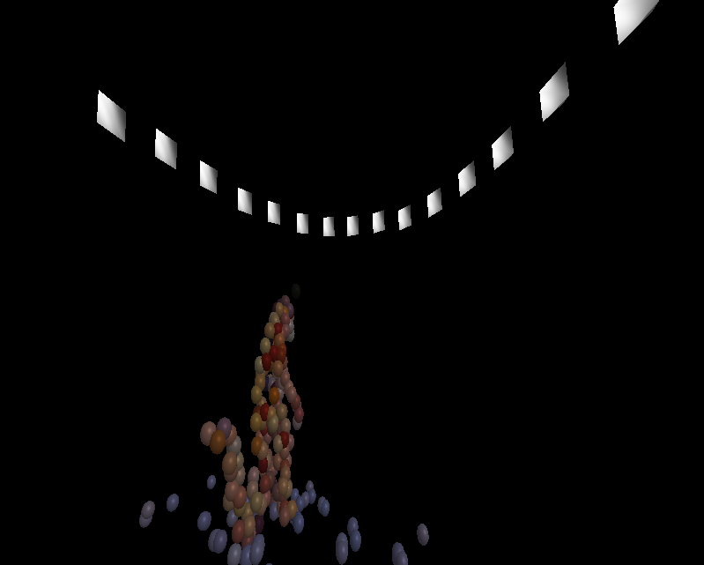
TSBB15 3D Reconstruction Group 2 “Epipolarna”

Slide 2
Modules
2D correspondence extraction – Alexander
Main program and pipeline – Mattias
Non-linear optimization – Martin
Visualization – Gustav

Slide 3
The 3D Reconstruction pipeline
Noisy, lots of false positives.
False positives are mostly isolated.
Easy to handle with later processing steps.

Slide 4
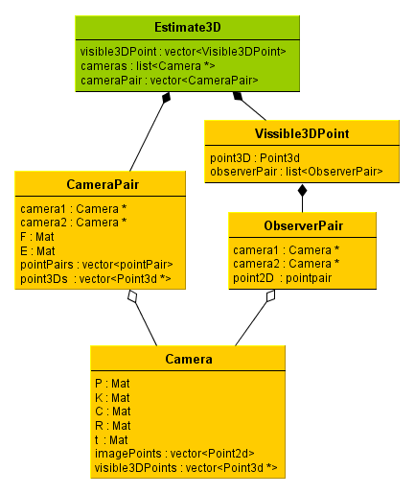
Data Structures
Data structure for cameras.
Links original 2D points to 3D points.
Links camera to visible points.

Slide 5
File output
Output each step of the reconstruction to a file.
Can be read by the visualizer for debugging/demonstration.
Or resume the reconstruction from a previous step.

Slide 6
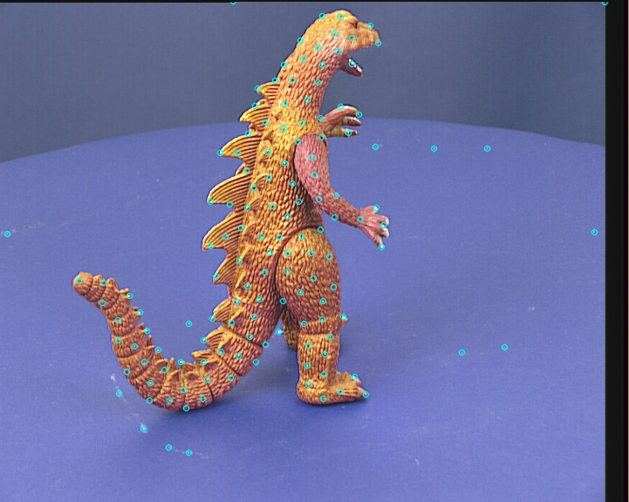
2D point extraction
Extract interesting points from images.
Some outliers present.

Slide 7
Estimation of R and t

Slide 8
Re-projection error
Project 3D points back into the camera
Error given in pixel distance

Slide 9
Gold Standard estimation of F
Gold Standard estimation of F
PnP pose estimation
Bundle adjustment

Slide 10
Solving the PnP
Rotation parameterization
Rotation vector representation
Allows for unconstrained optimization
Ambiguity in the mapping from matrix to parameter vector

Slide 11
Bundle Adjustment
Minimize total re-projection error
Implemented using levmar
Slow because of
No sparse pattern for Jacobian estimation
Library was not build using LAPACK

Slide 12
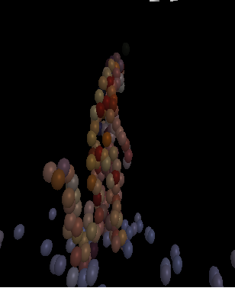
Visualization
Plot the estimated cameras
Plot the 3D points.
Points colored from original image data.

Slide 13
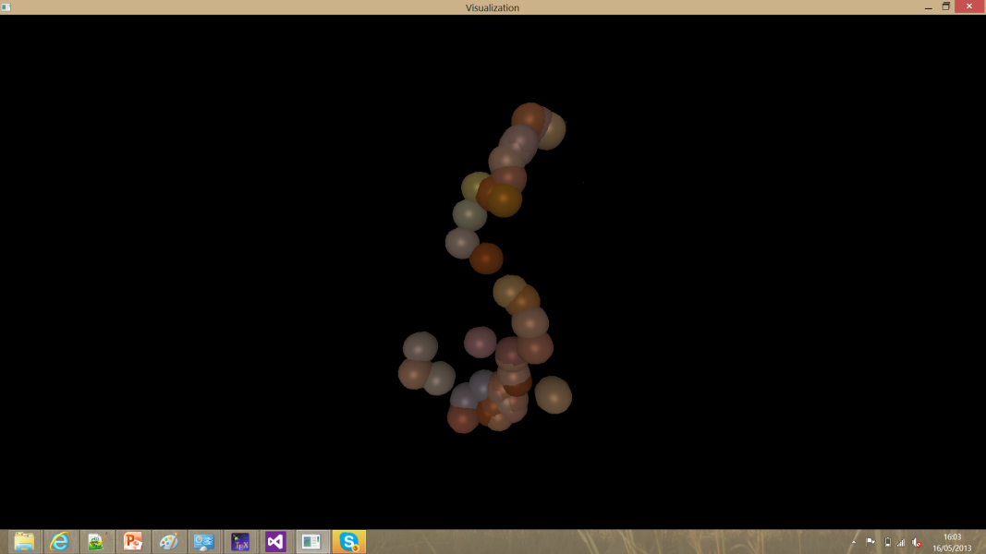
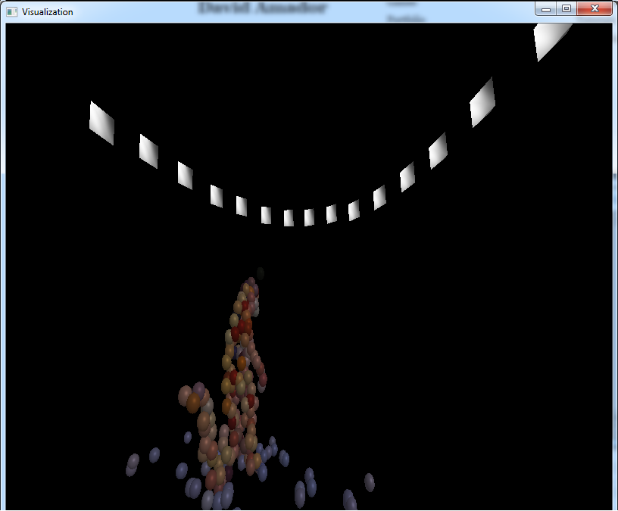
Evaluation
Slow, especially bundle adjustment step.
Very good results though.
Sensitive to outliers.

Slide 14
Results
Very slow for many cameras.
But it works.
It is awsome.

